Slide 1

Types of Fuel Cells
Agenda
Science Presentation
●What is a Fuel Cell?
● How Fuel Cells Work
● Types of Fuel Cells
● Proton Exchange Membrane Fuel Cells (PEMFC)
● Phosphoric Acid Fuel Cells (PAFC)
● Molten Carbonate Fuel Cells (MCFC)
● Solid Oxide Fuel Cells (SOFC)
● Advantages of Fuel Cells

Slide 2
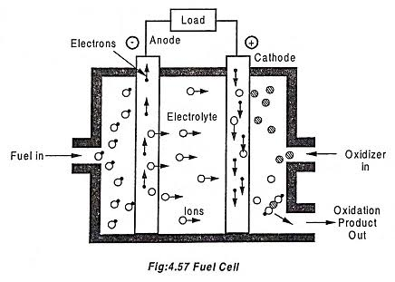
What is a Fuel Cell?
Definition of a fuel cell : A fuel cell is an electrochemical device that converts chemical energy directly into electrical energy, utilizing a chemical reaction between hydrogen and oxygen.
Basic components : A typical fuel cell consists of three main components: the anode, the cathode, and the electrolyte, which allow for the conversion of fuels into usable energy.
Comparison with traditional energy sources :Fuel cells provide a more efficient and cleaner alternative to traditional energy sources like fossil fuels. They produce electricity with minimal environmental impact.

Slide 3
How Fuel Cells Work
Overview of the electrochemical process
Fuel cells operate through electrochemical reactions, where hydrogen fuel is oxidized at the anode, releasing electrons that create an electric current.
Chemical reactions
In a fuel cell, hydrogen gas reacts with oxygen from the air to produce water and electricity as byproducts. The overall reaction can be summarized as: 2H2 + O2 → 2H2O + energy.
Role of electrodes and electrolyte : The anode (negative electrode) facilitates the oxidation of hydrogen, while the cathode (positive electrode) enables the reduction of oxygen. The electrolyte allows ions to move between the electrodes, completing the circuit.

Slide 4
Types of Fuel Cells
Proton Exchange Membrane Fuel Cells (PEMFC):
PEMFCs are highly efficient fuel cells that operate at low temperatures and are commonly used in hydrogen fuel cell vehicles due to their quick start-up capability.
Phosphoric Acid Fuel Cells (PAFC) :
Using phosphoric acid as an electrolyte, PAFCs are suitable for stationary applications, such as backup power systems, offering good durability and relatively low operating costs.
Molten Carbonate Fuel Cells (MCFC) :
MCFCs utilize molten carbonate salts as the electrolyte. They are ideal for large power generation and industrial applications due to their ability to operate at high temperatures.
Solid Oxide Fuel Cells (SOFC) :SOFCs use a solid oxide or ceramic electrolyte and are known for their high efficiency and versatility in using various fuels, making them suitable for stationary power generation.

Slide 5
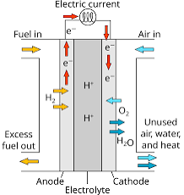
Proton Exchange Membrane Fuel Cells (PEMFC)
Key characteristics :
PEMFCs feature fast start-up times and operate effectively at low temperatures, making them ideal for various applications.
Applications: Commonly used in fuel cell vehicles (FCVs) and portable power devices like smartphones and laptops, PEMFCs are becoming increasingly popular.
Advantages :These fuel cells are lightweight, efficient, and environmentally friendly, emitting only water vapor and heat as byproducts.

Slide 6
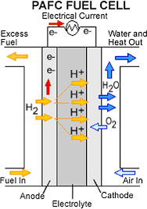
Phosphoric Acid Fuel Cells (PAFC):
How it works:
PAFCs operate using phosphoric acid as an electrolyte, which allows for the conduction of protons while blocking electrons.
Typical applications:
They are often used for commercial power generation, including power plants and backup power systems for buildings.
Strengths:
PAFCs are known for their durability and relatively low operating costs, making them a practical choice for long-term applications.

Slide 7
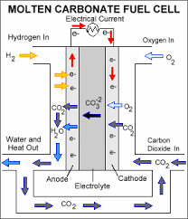
Molten Carbonate Fuel Cells (MCFC)
Description :
MCFCs feature molten carbonate salts as the electrolyte, which facilitate the movement of ions while allowing for high-temperature reactions.
Best suited for :
These fuel cells are excellent for large-scale power generation, particularly in industrial applications, due to their high efficiency.
Considerations :
Though they operate at high temperatures, this provides fuel flexibility and greater efficiency in power generation.

Slide 8
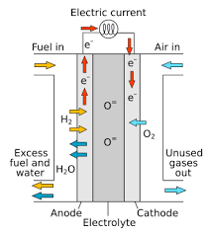
Solid Oxide Fuel Cells (SOFC)
Description:
SOFCs utilize a solid oxide or ceramic material as the electrolyte, which allows for ionic conduction at high temperatures.
Applications:
They are commonly used for stationary power generation and in combined heat and power (CHP) systems, providing both heat and electricity.
Benefits :
SOFCs offer high efficiency and can operate on various fuels, including natural gas and biogas, making them versatile.

Slide 9
Advantages of Fuel Cells
Environmentally friendly:
Fuel cells emit only water and heat, making them much cleaner compared to traditional combustion methods.
High efficiency :
They achieve higher efficiencies than combustion engines, translating to better energy conversion and reduced fuel consumption.
Versatility :
Fuel cells can be used in a wide array of applications, ranging from portable electronics to transportation and large-scale power generation.

